Slide 1
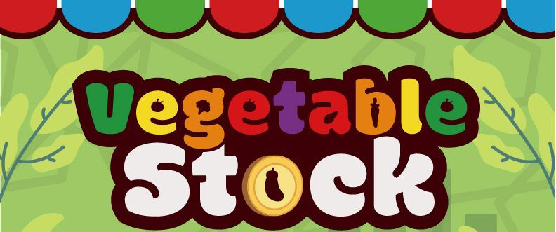
Play:
Deal # cards = # players +1
Each player takes 1 card.
Increase all price levels by 1 per vegetable on the remaining card.
If price > 5, goes down to 0.
Play 6 times.
Scoring:
Total across Vegetables of:
Total of each Veg held
X
The final price of each Veg.
2-4 players
Setup:
If 2/3 players remove 1 type of vegetable.
Line up 1 price card /veg and put veg at random levels on top of each.
Variants:
Back side of cards nonlinear.
Sun: 1 extra card.
Typhoon, can’t crash prices.

